Slide 1
VPN
VPN stands for "Virtual Private Network" and describes the opportunity to establish a protected network connection when using public networks. VPNs encrypt your internet traffic and disguise your online identity. This makes it more difficult for third parties to track your activities online and steal data. The encryption takes place in real time.

Slide 2
GRE
Generic Routing Encapsulation

Slide 3
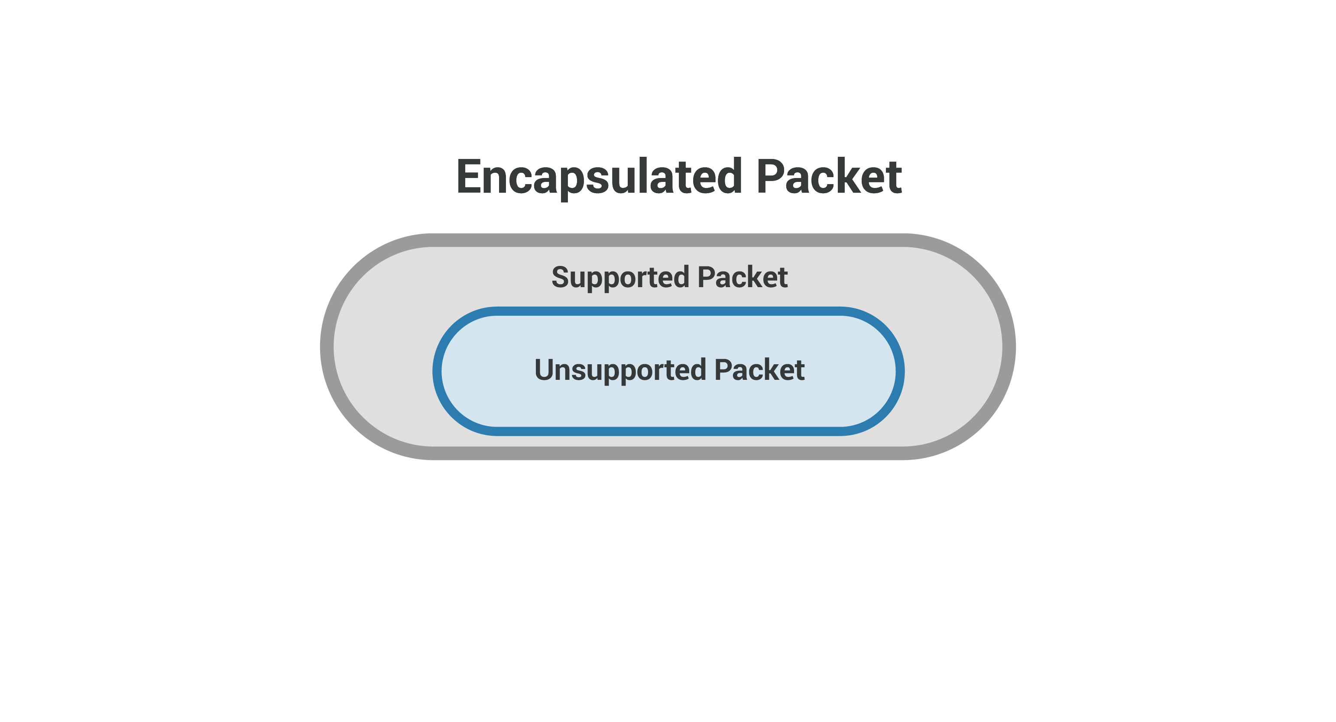
Generic Routing Encapsulation (GRE) is a tunneling protocol developed by Cisco Systems that can encapsulate a wide variety of network layer protocols inside virtual point-to-point links or point-to-multipoint links over an Internet Protocol network.
GRE provides a secure path for transporting packets of data by tunneling the packets
GRE encapsulates data packets and redirects them to a device that de-encapsulates them and routes them to their final destination. This allows the source and destination switches to operate as if they have a virtual point-to-point connection with each.
What is GRE?
Generic Routing Encapsulation, or GRE, is a protocol for encapsulating data packets that use one routing protocol inside the packets of another protocol. "Encapsulating" means wrapping one data packet within another data packet, like putting a box inside another box.
GRE is one way to set up a direct point-to-point connection across a network, for the purpose of simplifying connections between separate networks. It works with a variety of network layer protocols.

Slide 4
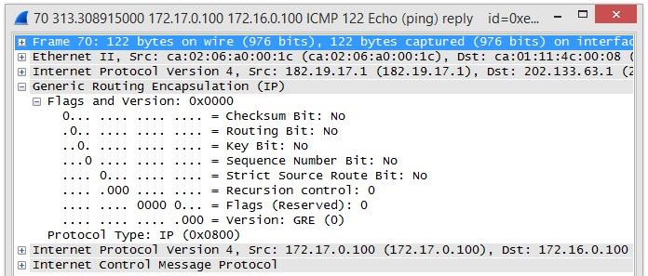

Slide 5
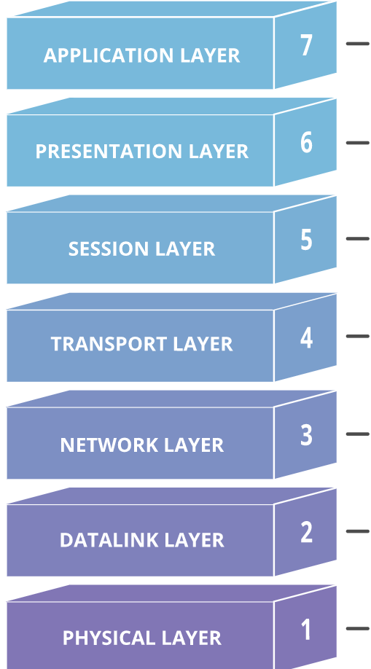
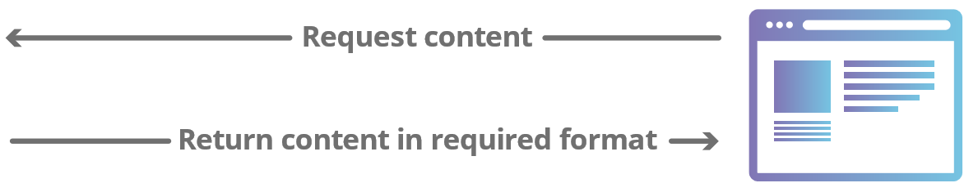
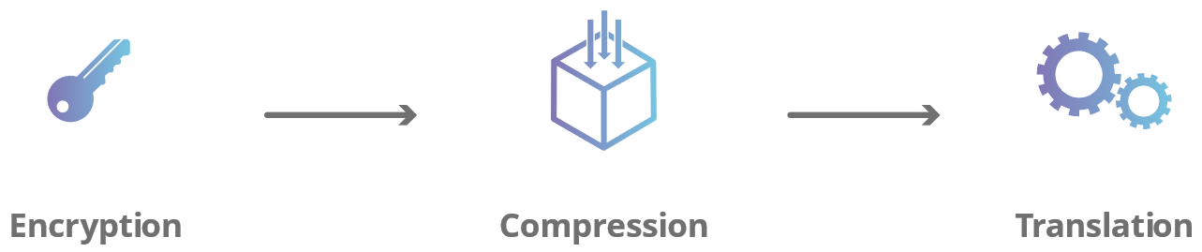
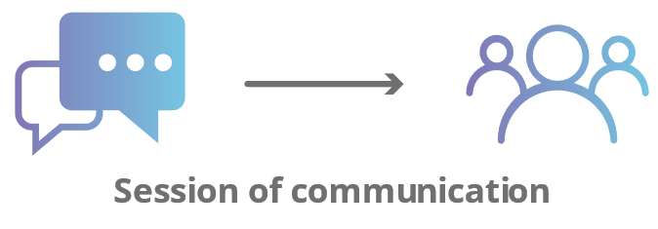
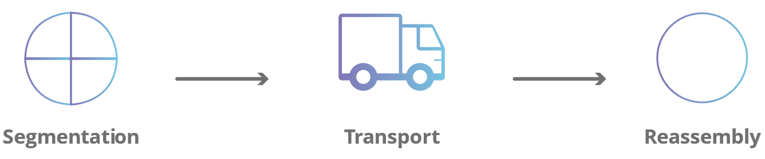
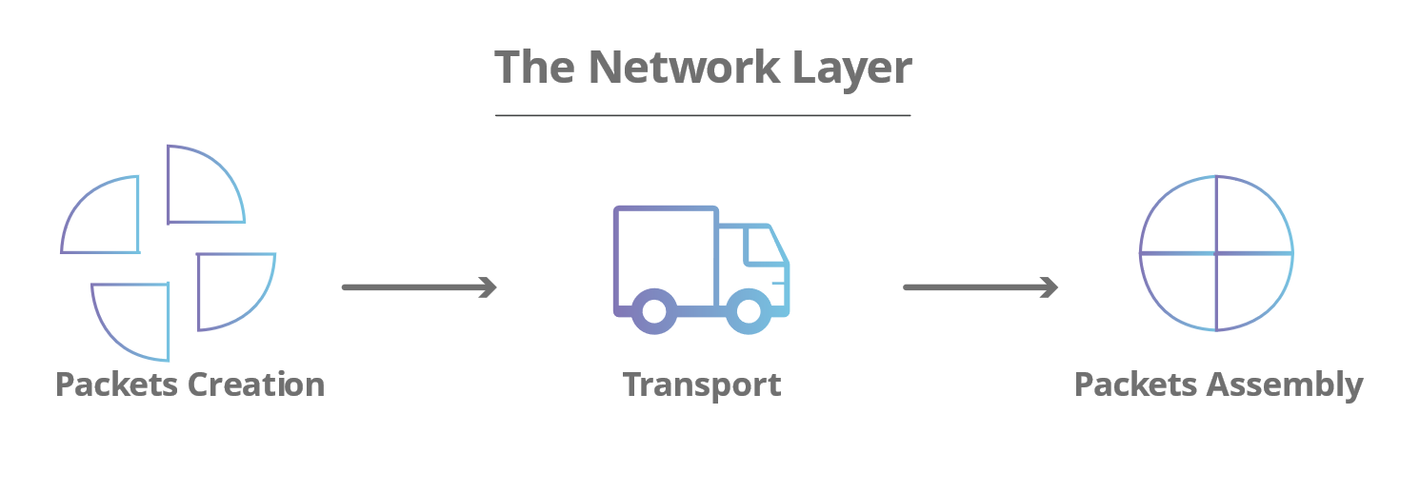
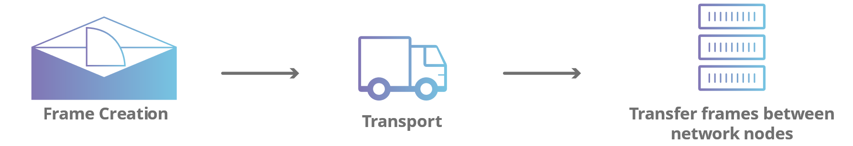
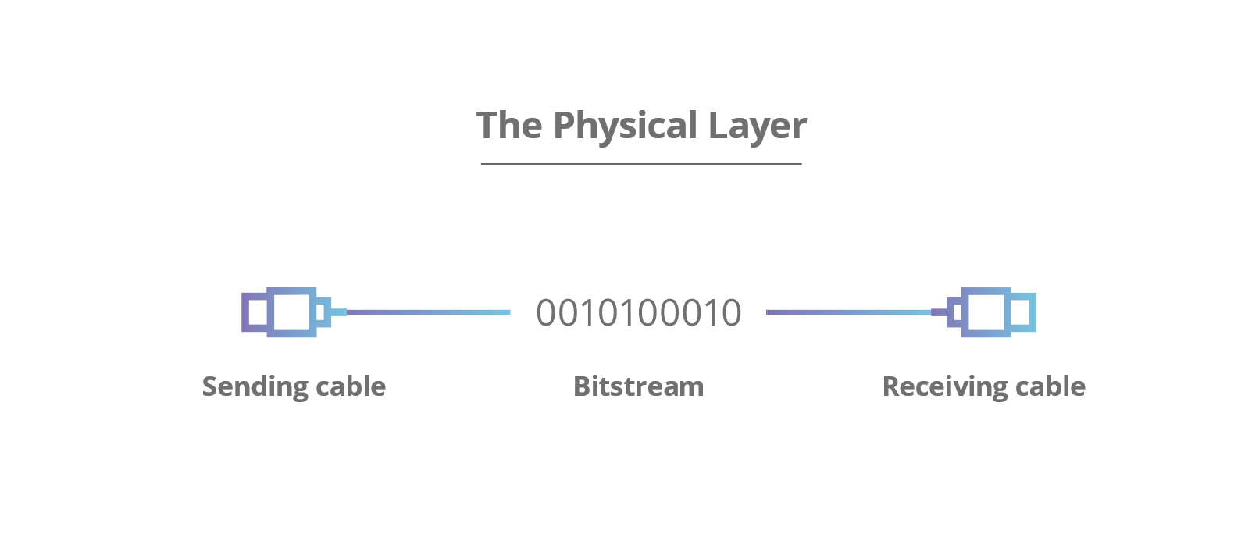
SMTP, FTP, HTTP/S
HTTP/S, SSL
NetBIOS
TCP, UDP, (Email, Streaming)
Addressing, Routing, Path management
Multiplexing
Media access portion, Addressing, Service access points, Upper layer data, Frame protection
Analog Signaling
Digital Signaling

Slide 6
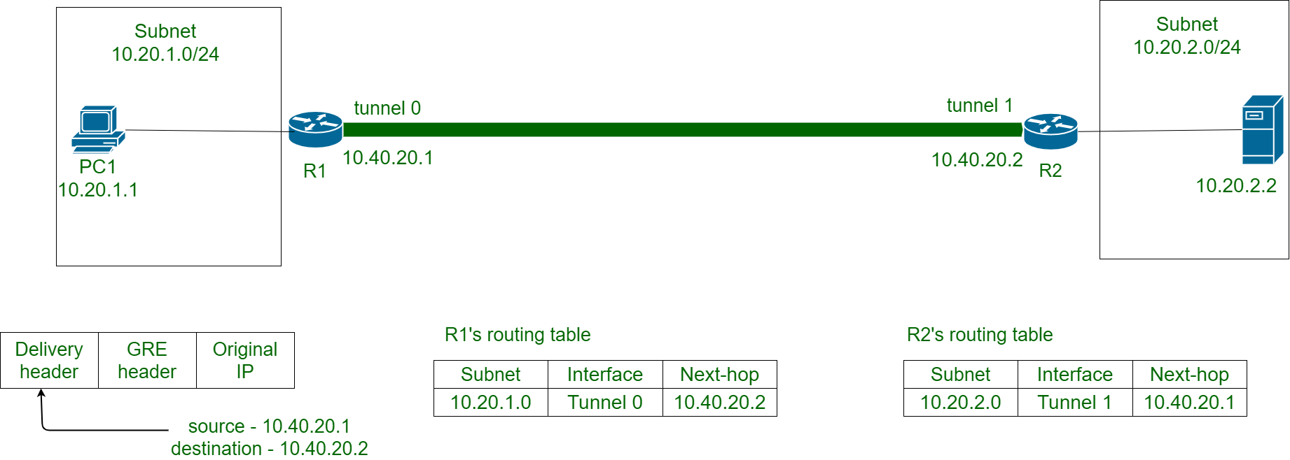

Slide 7
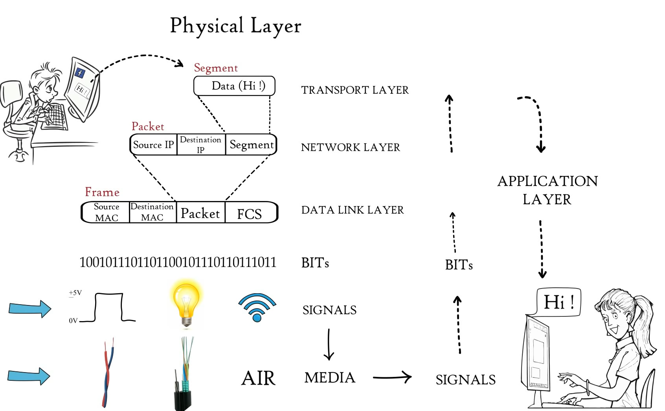
Frame
Check
sequence
Hub, Repeater, Modem, Cables are Physical Layer devices.

Slide 8
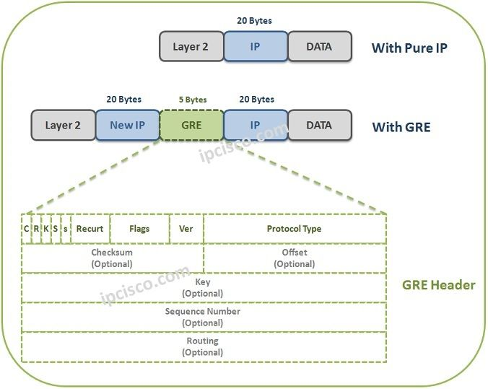
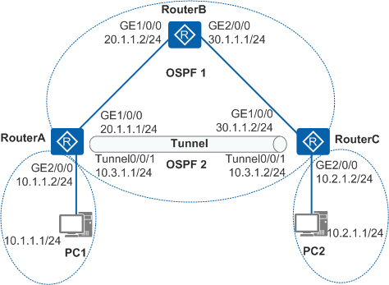
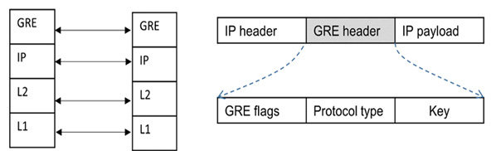
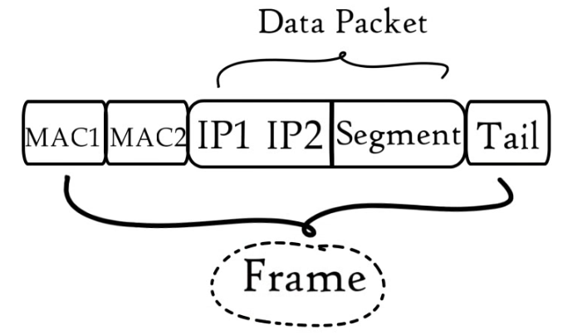

Slide 9
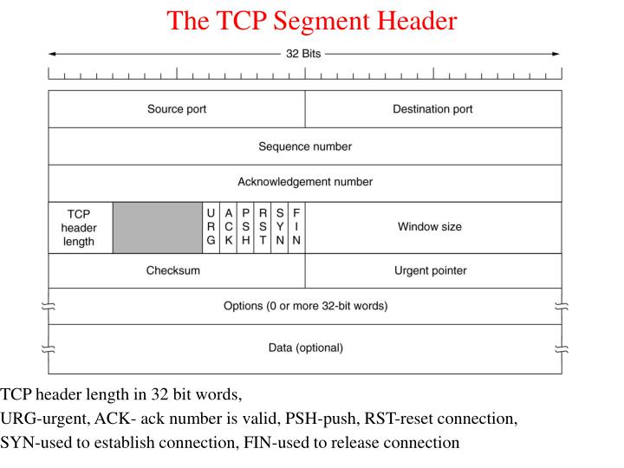
TCP is reliable protocol, TCP ensures that the data reaches intended destination
TCP ensures that the data reaches intended destination & FLOW CONTROL, quality of service.

Slide 10
